Slide 1
ECEG-5193: Algorithm Analysis and Design
Algorithms of Graph Problems
Algorithms for fundamental graph problems

Slide 2
Maximum Flow
Flow Networks

Slide 3
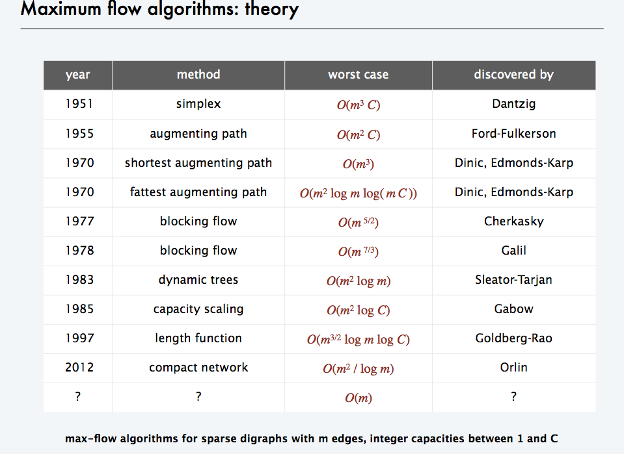

Slide 4
Flow networks:
A flow network G=(V,E): a directed graph, where each edge (u, v)∈E has a nonnegative capacity c(u, v) ≥ 0.
If (u, v)∉E, we assume that c(u, v) = 0.
two distinct vertices : a source s and a sink t.
12
16
20
s
10
9
7
t
4
13
4
14

Slide 5
Flow:
A flow in G: a real-valued function f satisfying the following two properties:
Capacity constraint: For all u, v ∈ V,
we require f(u, v) ≤ c( u, v).
Flow conservation: For all u ∈V-{s, t}, we require
Notes:
a real-valued function f:V*V → R

Slide 6
Net flow and value of a flow f:
The quantity f(u,v) is called the net flow from vertex u to vertex v.
The value of a flow is defined as
The total flow from source to any other vertices.
The same as the total flow from any vertices to the sink.

Slide 7
12/12
11/16
15/20
s
10
t
1/4
4/9
7/7
8/13
4/4
11/14
A flow f in G with value .

Slide 8
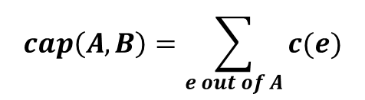
Cuts
Def. An s-t cut is a partition (A, B) of V with
s ∈ A and t ∈ B.
Def. The capacity of a cut (A, B) is:
$$cap\left(A,B\right)=\sum_{e out of A}{c(e)}$$
2
9
5
10
10
4
15
15
s
5
3
8
6
10
t
A
4
6
15
10
15
4
30
7
Capacity = 10 + 5 + 15
= 30
Notes:
8

Slide 9
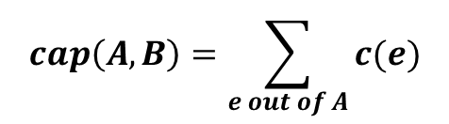
Cuts
Def. An s-t cut is a partition (A, B) of V with s ∈ A and t ∈ B.
Def. The capacity of a cut (A, B) is:
$$cap\left(A,B\right)=\sum_{e out of A}{c(e)}$$
2
9
5
10
4
15
15
10
s
5
3
8
6
10
t
A
4
15
15
6
10
4
30
7
Capacity = 9 + 15 + 8 + 30
= 62
Notes:
9
7->3 not counted

Slide 10
Minimum Cut Problem
Min s-t cut problem. Find an s-t cut of minimum capacity.
2
9
5
10
4
15
15
10
s
5
3
8
6
10
t
A
4
6
15
10
15
4
30
7
Capacity = 10 + 8 + 10
= 28
Notes:
10

Slide 11
Maximum Flow Problem
Max flow problem. Find s-t flow of maximum value.
9
2
9
5
10
1
9
10
4
0
15
15
0
10
4
8
9
s
5
3
8
6
10
t
4
10
capacity
4
0
6
15
0
10
flow
15
14
14
Value = 28
4
30
7
Notes:
11
Equalize inflow and outflow at every intermediate node.
Maximize flow sent from s to t.

Slide 12
Flows and Cuts
Flow value lemma. Let f be any flow, and let (A, B) be any s-t cut. Then, the net flow sent across the cut is equal to the amount leaving s.
6
2
9
5
10
0
6
10
4
4
15
15
0
10
3
8
8
s
5
3
8
6
10
t
A
1
10
4
0
6
15
0
10
15
11
11
Value = 24
4
30
7
Notes:
12

Slide 13
Flows and Cuts
Flow value lemma. Let f be any flow, and let (A, B) be any s-t cut. Then, the net flow sent across the cut is equal to the amount leaving s.
6
2
9
5
10
0
6
10
4
4
15
15
0
10
3
8
8
s
5
3
8
6
10
t
A
1
10
4
0
6
15
0
10
15
11
11
4
30
7
Value = 6 + 0 + 8 - 1 + 11
= 24
Notes:
13
total amount of flow that leaves S minus amount flow that "swirls" back

Slide 14
Flows and Cuts
Flow value lemma. Let f be any flow, and let (A, B) be any s-t cut. Then, the net flow sent across the cut is equal to the amount leaving s.
6
2
9
5
10
0
6
10
4
4
15
15
0
10
3
8
8
s
5
3
8
6
10
t
A
1
10
4
0
6
15
0
10
15
11
11
4
30
7
Value = 10 - 4 + 8 - 0 + 10
= 24
Notes:
14

Slide 15
Flows and Cuts
Weak duality. Let f be any flow, and let (A, B) be any s-t cut. Then the value of the flow is at most the capacity of the cut.
Cut capacity = 30 ⇒ Flow value ≤ 30
2
9
5
10
4
15
15
10
s
5
3
8
6
10
t
A
4
6
15
10
15
4
30
7
Capacity = 30
Notes:
15

Slide 16
Towards a Max Flow Algorithm
Greedy algorithm.
  Start with f(e) = 0 for all edge e ∈ E.
  Find an s-t path P where each edge has f(e) < c(e).
  Augment flow along path P.
  Repeat until you get stuck.
1
0
0
20
10
s
30
0
t
10
20
0
0
Flow value = 0
2
Notes:
16

Slide 17
Towards a Max Flow Algorithm
Greedy algorithm.
  Start with f(e) = 0 for all edge e ∈ E.
  Find an s-t path P where each edge has f(e) < c(e).
  Augment flow along path P.
  Repeat until you get stuck.
1
20
0
0
X
20
10
30
0
20
t
s
X
10
20
0
0
20
X
Flow value = 20
2
Notes:
17

Slide 18
Towards a Max Flow Algorithm
Greedy algorithm.
  Start with f(e) = 0 for all edge e ∈ E.
  Find an s-t path P where each edge has f(e) < c(e).
  Augment flow along path P.
  Repeat until you get stuck.
locally optimality ⇒ global optimality
1
1
20
0
20
10
20
10
20
10
s
30
20
t
s
30
10
t
10
20
10
20
0
20
10
20
greedy = 20
2
opt = 30
2
Notes:
18

Slide 19
Residual Graph
Original edge: e = (u, v) ∈ E.
  Flow f(e), capacity c(e).
Residual edge.
  "Undo" flow sent.
  e = (u, v) and e^{R} = (v, u).
  Residual capacity:
Residual graph: G_{f} = (V, E_{f} ).
  Residual edges with positive residual capacity.
  E_{f} = {e : f(e) < c(e)} ∪ {e^{R} : c(e) > 0}.
capacity
u
17
v
6
flow
residual capacity
u
11
v
6
residual capacity
Notes:
19

Slide 20
Maximum Flow
A flow for a network N is said to be maximum if its value is the largest of all flows for N
The maximum flow problem consists of finding a maximum flow for a given network N
Applications
  Hydraulic systems
  Electrical circuits
  Traffic movements
  Freight transportation

Slide 21
Applications
- Nontrivial applications / reductions.
  - Data mining.
  - Open-pit mining.
  - Project selection.
  - Airline scheduling.
  - Bipartite matching.
  - Baseball elimination.
  - Image segmentation.
  - Network connectivity.
  Network reliability.
  Distributed computing.
  Egalitarian stable matching.
  Security of statistical data.
  Network intrusion detection.
  Multi-camera scene reconstruction.
  Many many more . . .
Notes:
21
Network intrusion detection: http://www.ieee-infocom.org/2003/papers/46_02.PDF

Slide 22
A Simple Flow Algorithm
Example 1

Slide 23
Maximum Flow
v
1/3
2/6
1/1
3/7
t
s
3/3
w
1/1
2/9
4/5
3/5
u
2/2
z
Flow = 2 + 3 + 3 = 1 + 3 + 4 = 8
v
3/3
4/6
1/1
3/7
t
s
3/3
w
1/1
2/9
4/5
3/5
u
2/2
z
Maximum flow = 4 + 3 + 3 = 3 + 3 + 4 = 10

Slide 24
A Simple Flow Algorithm
Initialize all edges of the flow graph with zero flow
Loop while ∃ a path in G_{r} from s to t
  find a path in G_{r} from s to t (augmenting path)
  Add to the flow graph the minimum residual capacity
    from this path
  Reduce the residual capacity of the edges
end Loop
Flow Graph (G_{f})
Residual Graph (G_{r})
v
/3
v
3
/6
6
/1
1
/7
t
7
t
s
/3
s
3
w
w
/1
/9
/5
1
9
5
/5
5
u
/2
z
u
2
z

Slide 25
A Simple Flow Algorithm
Initialize all edges of the flow graph with zero flow
Loop while ∃ a path in G_{r} from s to t
  find a path in G_{r} from s to t (augmenting path)
  Add to the flow graph the minimum residual capacity
    from this path
  Reduce the residual capacity of the edges
end Loop
Flow Graph (G_{f})
Residual Graph (G_{r})
v
0/3
v
3
0/6
6
0/1
1
0/7
t
7
t
s
0/3
s
3
w
w
0/1
0/9
0/5
1
9
5
0/5
5
u
0/2
z
u
2
z

Slide 26
A Simple Flow Algorithm
Initialize all edges of the flow graph with zero flow
Loop while ∃ a path in G_{r} from s to t
  find a path in G_{r} from s to t (augmenting path)
  Add to the flow graph the minimum residual capacity
    from this path
  Reduce the residual capacity of the edges
end Loop
Flow Graph (G_{f})
Residual Graph (G_{r})
v
0/3
v
3
0/6
6
0/1
1
0/7
t
7
t
s
0/3
s
3
w
w
0/1
0/9
0/5
1
9
5
0/5
5
u
0/2
z
u
2
z

Slide 27
A Simple Flow Algorithm
Initialize all edges of the flow graph with zero flow
Loop while ∃ a path in G_{r} from s to t
  find a path in G_{r} from s to t (augmenting path)
  Add to the flow graph the minimum residual capacity
    from this path
  Reduce the residual capacity of the edges
end Loop
Flow Graph (G_{f})
Residual Graph (G_{r})
v
0/3
v
3
0/6
6
0/1
1
0/7
t
7
t
s
0/3
s
3
w
w
0/1
0/9
2/5
1
9
3
2/5
3
u
2/2
z
u
z

Slide 28
A Simple Flow Algorithm
Initialize all edges of the flow graph with zero flow
Loop while ∃ a path in G_{r} from s to t
  find a path in G_{r} from s to t (augmenting path)
  Add to the flow graph the minimum residual capacity
    from this path
  Reduce the residual capacity of the edges
end Loop
Flow Graph (G_{f})
Residual Graph (G_{r})
v
0/3
v
3
0/6
6
0/1
1
0/7
t
7
t
s
0/3
s
3
w
w
0/1
0/9
2/5
1
9
3
2/5
3
u
2/2
z
u
z

Slide 29
A Simple Flow Algorithm
Initialize all edges of the flow graph with zero flow
Loop while ∃ a path in G_{r} from s to t
  find a path in G_{r} from s to t (augmenting path)
  Add to the flow graph the minimum residual capacity
    from this path
  Reduce the residual capacity of the edges
end Loop
Flow Graph (G_{f})
Residual Graph (G_{r})
v
0/3
v
3
0/6
6
0/1
1
0/7
t
7
t
s
3/3
s
w
w
0/1
3/9
5/5
1
6
2/5
3
u
2/2
z
u
z

Slide 30
A Simple Flow Algorithm
Initialize all edges of the flow graph with zero flow
Loop while ∃ a path in G_{r} from s to t
  find a path in G_{r} from s to t (augmenting path)
  Add to the flow graph the minimum residual capacity
    from this path
  Reduce the residual capacity of the edges
end Loop
Flow Graph (G_{f})
Residual Graph (G_{r})
v
0/3
v
3
0/6
6
0/1
1
0/7
t
7
t
s
3/3
s
w
w
0/1
3/9
5/5
1
6
2/5
3
u
2/2
z
u
z

Slide 31
A Simple Flow Algorithm
Initialize all edges of the flow graph with zero flow
Loop while ∃ a path in G_{r} from s to t
  find a path in G_{r} from s to t (augmenting path)
  Add to the flow graph the minimum residual capacity
    from this path
  Reduce the residual capacity of the edges
end Loop
Flow Graph (G_{f})
Residual Graph (G_{r})
v
3/3
v
3/6
3
0/1
1
0/7
t
7
t
s
3/3
s
w
w
0/1
3/9
5/5
1
6
2/5
3
u
2/2
z
u
z

Slide 32
A Simple Flow Algorithm
Initialize all edges of the flow graph with zero flow
Loop while ∃ a path in G_{r} from s to t
  find a path in G_{r} from s to t (augmenting path)
  Add to the flow graph the minimum residual capacity
    from this path
  Reduce the residual capacity of the edges
end Loop
Flow Graph (G_{f})
Residual Graph (G_{r})
v
3/3
v
3/6
3
0/1
1
0/7
t
7
t
s
3/3
s
w
w
0/1
3/9
5/5
1
6
2/5
3
u
2/2
z
u
z

Slide 33
A Simple Flow Algorithm
Initialize all edges of the flow graph with zero flow
Loop while ∃ a path in G_{r} from s to t
  find a path in G_{r} from s to t (augmenting path)
  Add to the flow graph the minimum residual capacity
    from this path
  Reduce the residual capacity of the edges
end Loop
Flow Graph (G_{f})
Residual Graph (G_{r})
v
3/3
v
3/6
3
0/1
1
1/7
t
6
t
s
3/3
s
w
w
1/1
3/9
5/5
6
3/5
2
u
2/2
z
u
z

Slide 34
A Simple Flow Algorithm
Initialize all edges of the flow graph with zero flow
Loop while ∃ a path in G_{r} from s to t
  find a path in G_{r} from s to t (augmenting path)
  Add to the flow graph the minimum residual capacity
    from this path
  Reduce the residual capacity of the edges
end Loop
Flow Graph (G_{f})
Residual Graph (G_{r})
v
3/3
v
3/6
3
0/1
1
1/7
t
6
t
s
3/3
s
w
w
1/1
3/9
5/5
6
3/5
2
u
2/2
z
u
z

Slide 35
A Simple Flow Algorithm
Initialize all edges of the flow graph with zero flow
Loop while ∃ a path in G_{r} from s to t
  find a path in G_{r} from s to t (augmenting path)
  Add to the flow graph the minimum residual capacity
    from this path
  Reduce the residual capacity of the edges
end Loop
Flow Graph (G_{f})
Residual Graph (G_{r})
v
3/3
v
4/6
2
1/1
2/7
t
5
t
s
3/3
s
w
w
1/1
3/9
5/5
6
3/5
2
u
2/2
z
u
z

Slide 36
A Simple Flow Algorithm
Example 2

Slide 37
A Simple Flow Algorithm
Initialize all edges of the flow graph with zero flow
Loop while ∃ a path in G_{r} from s to t
  find a path in G_{r} from s to t (augmenting path)
  Add to the flow graph the minimum residual capacity
    from this path
  Reduce the residual capacity of the edges
end Loop
Flow Graph (G_{f})
Residual Graph (G_{r})
/2
2
v
w
v
w
/2
/3
2
3
s
/1
/4
t
s
1
4
t
/3
/2
3
2
u
z
u
z
/3
3

Slide 38
A Simple Flow Algorithm
Initialize all edges of the flow graph with zero flow
Loop while ∃ a path in G_{r} from s to t
  find a path in G_{r} from s to t (augmenting path)
  Add to the flow graph the minimum residual capacity
    from this path
  Reduce the residual capacity of the edges
end Loop
Flow Graph (G_{f})
Residual Graph (G_{r})
0/2
2
v
w
v
w
0/2
0/3
2
3
s
0/1
0/4
t
s
1
4
t
0/3
0/2
3
2
u
z
u
z
0/3
3

Slide 39
A Simple Flow Algorithm
Initialize all edges of the flow graph with zero flow
Loop while ∃ a path in G_{r} from s to t
  find a path in G_{r} from s to t (augmenting path)
  Add to the flow graph the minimum residual capacity
    from this path
  Reduce the residual capacity of the edges
end Loop
Flow Graph (G_{f})
Residual Graph (G_{r})
0/2
2
v
w
v
w
0/2
3/3
2
s
0/1
3/4
t
s
1
1
t
3/3
0/2
2
u
z
u
z
0/3
3
Algorithm terminates with an sub-optimal flow solution

Slide 40
Backward Flow
Note the following example:
5
S
B
C
T
10
10
10
5
  Let's look at 2 possible sequences of augmenting paths:
    SBT (5), SCT (5), SBCT (5)
      Total Flow is 15
    SBCT (10), ????
      We seem to be stuck, since there is no forward path from S to T
      Yet the choice of paths should not affect our answer

Slide 41
Backward Flow
Note the following example:
5
S
B
C
T
10
10
10
10
5
5
10
10
10
S
B
C
T
10
5
5
10
5/10
10
S
B
C
T
15
5
5
5
10
S
B
C
T
15
10
5
5

Slide 42
Maximum-flow problem
Given a flow network G with source s and sink t
Find a flow of maximum value from s to t.
How to solve it efficiently?

Slide 43
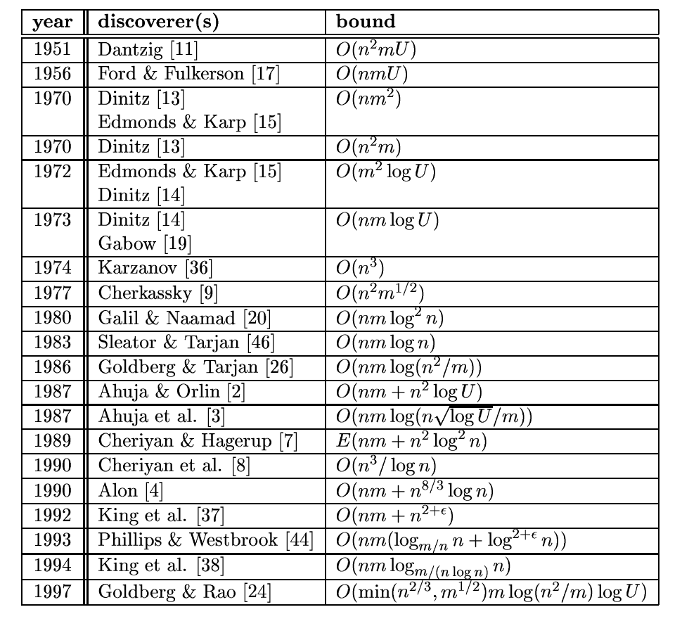
Some more history
Notes:
43
From: http://citeseer.ifi.unizh.ch/goldberg98recent.html

Slide 44
Augmenting Path Algorithm
Augment(f, c, P) {
b ← bottleneck(P)
foreach e ∈ P {
if (e ∈ E) f(e) ← f(e) + b
else f(e^{R}) ← f(e) - b
}
return f
}
forward edge
reverse edge
Ford-Fulkerson(G, s, t, c) {
foreach e ∈ E f(e) ← 0
G_{f} ← residual graph
while (there exists augmenting path P) {
f ← Augment(f, c, P)
update G_{f}
}
return f
}
Notes:
44

Slide 45
Ford-Fulkerson’s Algorithm
Initialize all edges of the flow graph with zero flow
Loop while ∃ a path in G_{r} from s to t
  find a path in G_{r} from s to t (augmenting path)
  Add to the flow graph the minimum residual capacity
    from this path
  Reduce the residual capacity of the edges
  Add a reversed path in the residual graph
end Loop
Residual Graph (G_{r})
Flow Graph (G_{f})
0/2
2
v
w
v
w
0/2
0/3
2
3
s
0/1
0/4
t
s
1
4
t
0/3
0/2
3
2
u
z
u
z
0/3
3

Slide 46
Ford-Fulkerson’s Algorithm
Initialize all edges of the flow graph with zero flow
Loop while ∃ a path in G_{r} from s to t
  find a path in G_{r} from s to t (augmenting path)
  Add to the flow graph the minimum residual capacity
    from this path
  Reduce the residual capacity of the edges
  Add a reversed path in the residual graph
end Loop
Residual Graph (G_{r})
Flow Graph (G_{f})
0/2
2
v
w
v
w
0/2
3/3
2
-3
s
0/1
3/4
t
s
1
1
t
-3
3/3
0/2
-3
2
u
z
u
z
0/3
3

Slide 47
Ford-Fulkerson’s Algorithm
Initialize all edges of the flow graph with zero flow
Loop while ∃ a path in G_{r} from s to t
  find a path in G_{r} from s to t (augmenting path)
  Add to the flow graph the minimum residual capacity
    from this path
  Reduce the residual capacity of the edges
  Add a reversed path in the residual graph
end Loop
Residual Graph (G_{r})
Flow Graph (G_{f})
0/2
2
v
w
v
w
0/2
3/3
2
-3
s
0/1
3/4
t
s
1
1
t
-3
3/3
0/2
-3
2
u
z
u
z
0/3
3

Slide 48
Ford-Fulkerson’s Algorithm
Initialize all edges of the flow graph with zero flow
Loop while ∃ a path in G_{r} from s to t
  find a path in G_{r} from s to t (augmenting path)
  Add to the flow graph the minimum residual capacity
    from this path
  Reduce the residual capacity of the edges
  Add a reversed path in the residual graph
end Loop
Residual Graph (G_{r})
Flow Graph (G_{f})
2/2
-2
v
w
v
w
2/2
3/3
-2
-3
s
0/1
1/4
t
s
1
3
t
-1
3/3
2/2
-3
-2
-2
u
z
u
z
2/3
1

Slide 49
Analysis
Each augmenting path increases the flow value by at least 1.
Let |f*| is a maximum flow, then in the worst case, Ford-Fulkerson’s algorithm performs |f*| flow augmentations.
Finding an augmenting path and augmenting the flow takes O(n + m) time
The running time of Ford-Fulkerson’s algorithm is O(|f*|(n + m))

Slide 50
Analysis
v
50
50
Classic worst case
example:
s
1
t
50
50
u
Flow Graph (G_{f})
Residual Graph (G_{r})
v
v
0/50
1/50
50
49
s
s
-1
1/1
t
-1
-1
t
1/50
0/50
49
50
u
u

Slide 51
Analysis
v
50
50
Classic worst case
example:
s
1
t
50
50
u
Flow Graph (G_{f})
Residual Graph (G_{r})
v
v
1/50
1/50
49
49
-1
s
s
-1
0/1
t
1
t
-1
-1
1/50
1/50
49
49
u
u

Slide 52
Ford-Fulkerson Algorithm
Demo

Slide 53
Ford-Fulkerson Algorithm
0
flow
2
4
4
capacity
G:
0
0
0
10
2
0
8
6
0
10
0
0
0
s
10
3
9
5
10
t
Flow value = 0

Slide 54
Ford-Fulkerson Algorithm
0
flow
2
4
4
capacity
G:
8
0
0
X
0
8
X
10
2
0
8
6
0
10
0
8
0
0
X
s
10
3
9
5
10
t
8
Flow value = 0
2
4
4
residual capacity
G_{f}:
10
2
8
6
10
s
10
3
9
5
10
t

Slide 55
Ford-Fulkerson Algorithm
0
2
4
4
G:
10
8
0
X
8
10
2
0
8
6
0
10
X
2
0
10
8
0
2
X
X
s
10
3
9
5
10
t
10
Flow value = 8
2
4
4
G_{f}:
8
2
2
8
6
10
s
10
3
9
5
2
t
8

Slide 56
Ford-Fulkerson Algorithm
0
2
4
4
G:
0
6
10
8
X
8
6
0
10
2
2
X
10
6
0
6
10
X
2
8
X
s
10
3
9
5
10
t
16
Flow value = 10
2
4
4
G_{f}:
10
2
8
6
10
s
10
3
7
5
10
t
2

Slide 57
Ford-Fulkerson Algorithm
0
2
X
2
4
4
G:
6
8
10
8
X
10
2
2
8
6
6
10
X
0
6
8
10
X
8
18
s
10
3
9
5
10
t
Flow value = 16
2
4
4
G_{f}:
6
10
2
8
6
4
s
4
3
1
5
10
t
6
8

Slide 58
Ford-Fulkerson Algorithm
2
3
X
2
4
4
G:
8
9
10
8
7
X
X
10
2
0
8
6
6
10
8
9
10
X
8
9
X
s
10
3
9
5
10
t
19
Flow value = 18
2
2
2
4
G_{f}:
8
10
2
8
6
2
s
2
3
1
5
10
t
8
8

Slide 59
Ford-Fulkerson Algorithm
3
2
4
4
G:
10
7
9
10
2
0
8
6
6
10
9
9
10
s
10
3
9
5
10
t
Flow value = 19
3
2
1
4
G_{f}:
9
1
10
2
7
6
1
s
1
3
9
5
10
t
9

Slide 60
Ford-Fulkerson Algorithm
3
2
4
4
G:
10
7
9
10
2
0
8
6
6
10
9
9
10
s
10
3
9
5
10
t
Cut capacity = 19
Flow value = 19
3
2
1
4
G_{f}:
9
1
10
2
7
6
1
s
1
3
9
5
10
t
9

Slide 61
Time complexity
If each c(e) is an integer, then time complexity is O(|E|f*), where f* is the maximum flow.
Reason: each time the flow is increased by at least one.
This might not be a polynomial time algorithm since f* can be represented by log (f*) bits. So, the input size might be log(f*).

Slide 62
Choosing Good Augmenting Paths
Notes:
62

Slide 63
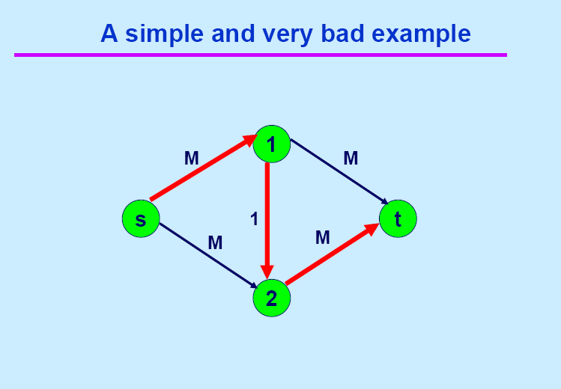

Slide 64
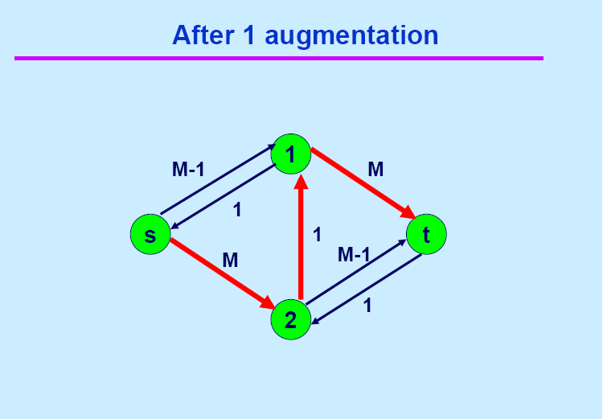

Slide 65
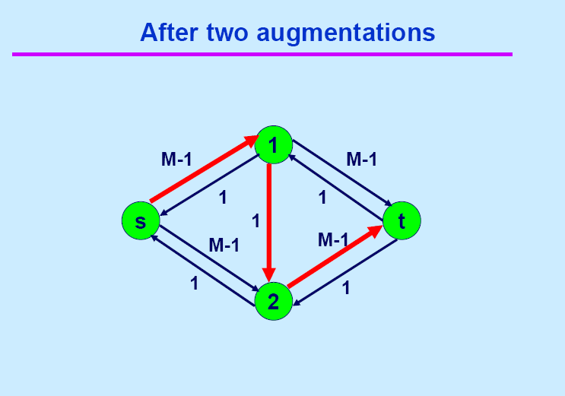

Slide 66
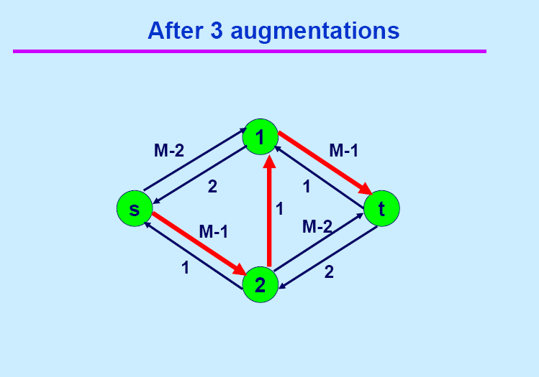

Slide 67
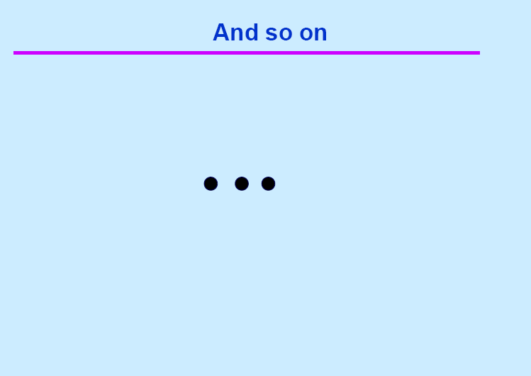

Slide 68
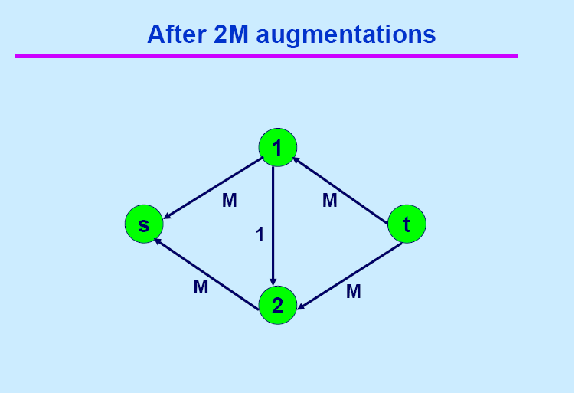

Slide 69
Ford-Fulkerson: Exponential Number of Augmentations
Q. Is generic Ford-Fulkerson algorithm polynomial in input size?
A. No. If max capacity is C, then algorithm can take C iterations.
m, n, and log C
1
1
1
0
0
1
0
0
X
X
X
1
C
C
C
C
1
0
t
1
0
1
0
t
s
X
1
s
X
X
C
C
C
C
0
0
1
0
0
1
X
1
X
X
2
2
Notes:
69

Slide 70
Choosing Good Augmenting Paths
Use care when selecting augmenting paths.
  Some choices lead to exponential algorithms.
  Clever choices lead to polynomial algorithms.
  If capacities are irrational, algorithm not guaranteed to terminate!
Goal: choose augmenting paths so that:
  Can find augmenting paths efficiently.
  Few iterations.
Notes:
70

Slide 71
Choosing Good Augmenting Paths
Choose augmenting paths with: [Edmonds-Karp 1972, Dinitz 1970]
  Max bottleneck capacity.
  Sufficiently large bottleneck capacity.
  Fewest number of edges.
Notes:
71

Slide 72
Capacity Scaling
Intuition. Choosing path with highest bottleneck capacity increases flow by max possible amount.
  Don't worry about finding exact highest bottleneck path.
  Maintain scaling parameter Δ.
  Let G_{f} (Δ) be the subgraph of the residual graph consisting of only arcs with capacity at least Δ.
4
4
110
102
110
102
s
1
t
s
t
122
170
122
170
2
2
G_{f}
G_{f} (100)
Notes:
72

Slide 73
Capacity Scaling
Scaling-Max-Flow(G, s, t, c) {
foreach e ∈ E f(e) ← 0
Δ ← smallest power of 2 greater than or equal to max c
G_{f} ← residual graph
while (Δ ≥ 1) {
G_{f}(Δ) ← Δ-residual graph
while (there exists augmenting path P in G_{f}(Δ)) {
f ← augment(f, c, P)
update G_{f}(Δ)
}
Δ ← Δ / 2
}
return f
}
Notes:
73

Slide 74
Capacity Scaling: Correctness
Assumption. All edge capacities are integers between 1 and C.
Integrality invariant. All flow and residual capacity values are integral.
Correctness. If the algorithm terminates, then f is a max flow.
Pf.
  By integrality invariant, when Δ = 1 ⇒ G_{f}(Δ) = G_{f}.
  Upon termination of Δ = 1 phase, there are no augmenting paths. ▪
Notes:
74

Slide 75
Capacity Scaling: Running Time
Lemma 1. The outer while loop repeats 1 + ⎡log₂ C⎤ times.
Pf. Initially Δ < C. Δ drops by a factor of 2 each iteration and never gets below 1.
Lemma 2. Let f be the flow at the end of a Δ-scaling phase. Then the value of the maximum flow is at most v(f) + m Δ.
Lemma 3. There are at most 2m augmentations per scaling phase.
  Let f be the flow at the end of the previous scaling phase.
  L2 ⇒ v(f*) ≤ v(f) + m (2Δ).
  Each augmentation in a Δ-phase increases v(f) by at least Δ.
Theorem. The scaling max-flow algorithm finds a max flow in O(m log C) augmentations. It can be implemented to run in O(m² log C) time. ▪
proof on next slide
Notes:
75

Slide 76
Capacity Scaling: Running Time
Lemma 2. Let f be the flow at the end of a Δ-scaling phase. Then value of the maximum flow is at most v(f) + m Δ.
Pf. (almost identical to proof of max-flow min-cut theorem)
  We show that at the end of a Δ-phase, there exists a cut (A, B) such that cap(A, B) ≤ v(f) + m Δ.
  Choose A to be the set of nodes reachable from s in G_{f}(Δ).
  By definition of A, s ∈ A.
  By definition of f, t ∉ A.
A
B
t
s
original network
Notes:
76
intuition: f is max flow in G_{f}(Δ). Adding back arc with capacity less than Δ can only increase capacity of cut by at most mΔ.

Slide 77
Capacity Scaling
S
5
S
6
11
S
1
7
1
S
14
12
S
10
S
Max(14, 6, 1, 5, 7, 10, 1, 12, 11) =

Slide 78
Capacity Scaling
S
5
S
6
11
S
1
7
1
S
14
12
S
10
S
Max(14, 6, 1, 5, 7, 10, 1, 12, 11) =
14

Slide 79
Capacity Scaling
S
5
S
6
11
S
1
7
1
S
14
12
S
10
S
Max(14, 6, 1, 5, 7, 10, 1, 12, 11) =
14
Δ = 2³ = 8; since, 2⁴ =16
Find an augmenting path whose edges are ≥ Δ (= 8 )

Slide 80
Capacity Scaling
S
5
S
6
11
S
1
7
1
S
14
12
S
10
S
Max(14, 6, 1, 5, 7, 10, 1, 12, 11) =
14
Δ = 2³ = 8; since, 2⁴ =16
Find an augmenting path whose edges are ≥ Δ (= 8 )

Slide 81
Capacity Scaling
S
5
S
6
11
S
1
7
1
S
10
10
14
12
10
10
10
S
10
S
10

Slide 82
Capacity Scaling
S
5
S
6
11
S
1
7
1
S
10
10
14
12
10
10
10
S
10
S
10
Δ = Δ /2 = 8/2 = 4
Find an augmenting path whose edges are ≥ 4

Slide 83
Capacity Scaling
S
5
S
6
11
S
1
7
1
S
10
10
14
12
10
10
10
S
10
S
10
Δ = Δ /2 = 8/2 = 4
Find an augmenting path whose edges are ≥ 4

Slide 84
Capacity Scaling
5
5
S
5
S
5
5
5
5
6
11
S
1
7
1
S
10
10
14
12
10
10
10
S
10
S
10

Slide 85
Capacity Scaling
5
5
S
5
S
5
5
5
5
6
11
S
1
7
1
S
10
10
14
12
10
10
10
S
10
S
10
Δ = 4
Find an augmenting path whose edges are ≥ 4

Slide 86
Capacity Scaling
5
S
5
5
S
5
5
5
11
5
6
S
1
7
1
S
10
10
14
12
10
10
10
S
10
S
10
Δ = Δ /2 = 8/2 = 4
Find an augmenting path whose edges are ≥ 4

Slide 87
Capacity Scaling
5
S
5
S
5
9
5
5
6
11
9
4
S
1
7
1
S
4
10
14
14
12
14
10
10
S
10
S
10

Slide 88
Capacity Scaling
5
S
5
S
5
9
5
5
6
11
9
4
S
1
7
1
S
4
10
14
14
12
14
10
10
S
10
S
10
Δ = Δ /2 = 4/2 = 2
Find an augmenting path whose edges are ≥ 2

Slide 89
Capacity Scaling
5
S
5
S
5
9
5
5
6
11
9
4
S
1
7
1
S
4
10
14
14
12
14
10
10
S
10
S
10
NO augmenting path whose edges are ≥ 2

Slide 90
Capacity Scaling
5
S
5
S
5
9
5
5
6
11
9
4
S
1
7
1
S
4
10
14
14
12
14
10
10
S
10
S
10
Δ = Δ /2 = 2/2 = 1
Find an augmenting path whose edges are ≥ 1

Slide 91
Capacity Scaling
5
S
5
S
5
9
5
5
6
11
9
4
S
1
7
1
S
4
10
14
14
12
14
10
10
S
10
S
10
Δ = Δ /2 = 2/2 = 1
Find an augmenting path whose edges are ≥ 1

Slide 92
Capacity Scaling
5
S
5
S
5
9
5
5
6
11
9
4
S
1
7
1
S
4
10
14
14
12
14
10
10
S
10
S
10

Slide 93
Capacity Scaling
5
S
5
S
5
10
6
6
6
1
11
10
5
S
1
1
7
1
S
5
10
14
14
12
14
10
10
S
10
S
10

Slide 94
Capacity Scaling
5
S
5
S
5
10
6
6
6
1
11
10
5
S
1
1
7
1
S
5
10
14
14
12
14
10
10
S
10
S
10
Δ = 1
NO augmenting path whose edges are ≥ 1

Slide 95
Capacity Scaling
5
S
5
S
5
10
6
6
6
1
11
10
5
S
1
1
7
1
S
5
10
14
14
12
14
10
10
S
10
S
10
Δ = Δ /2 = 1/2 = 0
Terminate the algorithm

Slide 96
Capacity Scaling
5
S
5
S
5
10
6
6
6
1
11
10
5
S
1
1
7
1
S
5
10
14
14
12
14
10
10
S
10
S
10
Flow = 10 + 10 = 20

Slide 97
Capacity Scaling
Time complexity
The capacity scaling works very well in practice.
Time complexity
  Using DFS : O(E²logU) or
  O(EVlogU) if the shortest augmenting path (like Edmond-Karp) is used

Slide 98
The
Edmonds-Karp
Algorithm

Slide 99
The Edmonds-Karp algorithm
Find the augmenting path using breadth-first search.
Breadth-first search gives the shortest path for graphs (Assuming the length of each edge is 1.)
Time complexity of Edmonds-Karp algorithm is O(VE²).
  Since the number of augmentations is O(VE)
The proof is very hard and is not required here.

Slide 100
Lemma
Proof

Slide 102
Lemma
Proof

Slide 103
Theorem
Proof

Slide 104
Edmonds-Karp Algorithm
Demo

Slide 105
Edmonds-Karp Algorithm
0
flow
2
4
4
G:
0
0
capacity
8
6
0
10
0
10
2
0
0
0
0
s
10
3
9
5
10
t
Flow value = 0

Slide 106
Edmonds-Karp Algorithm
0
flow
2
4
4
capacity
G:
8
0
0
X
0
8
X
10
2
0
8
6
0
10
0
8
0
0
X
s
10
3
9
5
10
t
8
Flow value = 0
2
4
4
residual capacity
G_{f}:
10
2
8
6
10
s
10
3
9
5
10
t

Slide 107
Edmonds-Karp Algorithm
0
2
X
2
4
4
G:
0
10
8
8
X
X
2
10
2
0
8
6
0
10
0
0
8
s
10
3
9
5
10
t
10
Flow value = 8
2
4
4
G_{f}:
8
2
2
8
6
10
s
10
3
9
5
2
t
8
107

Slide 108
2
2
4
4
G:
10
8
2
10
2
0
8
6
0
10
0
10
8
X
2
0
2
X
X
s
10
3
9
5
10
t
12
Flow value = 10
2
2
2
4
G_{f}:
2
10
2
8
6
8
s
10
3
9
5
2
t
8

Slide 109
2
2
4
4
G:
10
2
8
X
8
8
6
0
10
2
0
X
10
6
2
8
10
X
2
8
X
s
10
3
9
5
10
t
18
Flow value = 12
2
2
2
4
G_{f}:
2
10
2
8
6
8
s
8
3
7
5
10
t
2
2
109

Slide 110
2
3
X
2
4
4
G:
10
8
8
X
9
X
7
10
2
0
8
6
6
10
8
X
9
8
9
10
X
s
10
3
9
5
10
t
19
Flow value = 18
2
2
2
4
G_{f}:
8
10
2
8
6
2
s
2
3
1
5
10
t
8
8

Slide 111
3
2
4
4
G:
10
7
9
10
2
0
8
6
6
10
9
9
10
s
10
3
9
5
10
t
Flow value = 19
3
2
1
4
G_{f}:
9
1
10
2
7
6
1
s
1
3
9
5
10
t
9

Slide 112
3
2
4
4
G:
10
7
9
10
2
0
8
6
6
10
9
9
10
s
10
3
9
5
10
t
Cut capacity = 19
Flow value = 19
3
2
1
4
G_{f}:
9
1
10
2
7
6
1
s
1
3
9
5
10
t
9

Slide 113
Edmonds-Karp
Time complexity
The Edmonds-Karp algorithm uses a breadth first search to find augmenting paths which yields an arguably better time complexity of O(VE²)
The complexity no longer depends on the capacity value of any edge

Slide 114
Bipartite Graph
A bipartite graph is an undirected graph G=(V,E) in which V can be partitioned into two sets V₁ and V₂ such that (u,v) ∈ E implies either u ∈ V₁ and v ∈ V₁₂ or vice versa.
That is, all edges go between the two sets V₁ and V₂ and not within V₁ and V₂.

Slide 115
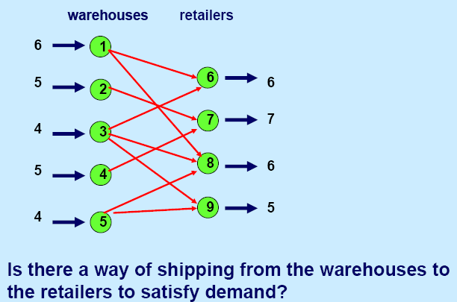
Application – Bipartite Matching

Slide 116
Application – Bipartite Matching
Example – given a community with n men and m women
Assume we have a way to determine which couples (man/woman) are compatible for marriage
  E.g. (Joe, Susan) or (Fred, Susan) but not (Frank, Susan)
Problem: Maximize the number of marriages
  No polygamy allowed
  Can solve this problem by creating a flow network out of a bipartite graph

Slide 117
Model for Matching Problem
❍

Example:
Matching a Person with a book that he/she prefers to take.
⓪

③

②

①

Notes:
⓪①②③

Slide 118
Model for Matching Problem
❍

Example:
Matching a Person with a book that he/she prefers to take.
⓪

③

②

①

Notes:
⓪①②③

Slide 119
Model for Matching Problem
❍

Example:
Matching a Person with a book that he/she prefers to take.
⓪

③

②

Let’s try
Greedy
①

Notes:
⓪①②③

Slide 120
Model for Matching Problem
❍

Example:
Matching a Person with a book that he/she prefers to take.
⓪

③

②

Let’s try
Greedy
①

Notes:
⓪①②③

Slide 121
Model for Matching Problem
❍

Example:
Matching a Person with a book that he/she prefers to take.
⓪

③

②

Let’s try
Greedy
①

Notes:
⓪①②③

Slide 122
Model for Matching Problem
❍

Example:
Matching a Person with a book that he/she prefers to take.
⓪

③

②

Let’s try
Greedy
①

Notes:
⓪①②③

Slide 123
Model for Matching Problem
❍

Example:
Matching a Person with a book that he/she prefers to take.
⓪

③

②

Let’s try
Greedy
①

Notes:
⓪①②③

Slide 124
Model for Matching Problem
❍

Example:
Matching a Person with a book that he/she prefers to take.
⓪

③

②

Let’s try
Greedy
①

Notes:
⓪①②③

Slide 125
Model for Matching Problem
❍

Example:
Matching a Person with a book that he/she prefers to take.
⓪

③

②

Let’s try
Greedy
①

Notes:
⓪①②③

Slide 126
Model for Matching Problem
❍

Example:
Matching a Person with a book that he/she prefers to take.
⓪

③

②

Let’s try
Greedy
①

Notes:
⓪①②③

Slide 127
Model for Matching Problem
❍

Example:
Matching a Person with a book that he/she prefers to take.
⓪

③

②

Let’s try
Greedy
①

Notes:
⓪①②③

Slide 128
Model for Matching Problem
Men on leftmost set, women on rightmost set, edges if they are compatible
A
A
X
A
X
X
B
B
B
Y
Y
Y
C
C
C
Z
Z
D
Z
D
D
Men
Women
A matching
Optimal matching

Slide 129
Solution Using Max Flow
Add a supersouce, supersink, make each undirected edge directed with a flow of 1
A
A
X
X
B
B
t
Y
s
Y
C
C
Z
Z
D
D
Since the input is 1, flow conservation prevents multiple matchings

Slide 130
Model for Matching Problem
❍

⓪

Can we do better?
③

②

①


Slide 131
Model for Matching Problem
❍

⓪

Make edges directed
③

②

①


Slide 132
Model for Matching Problem
❍

1
1
1
1
⓪

1
1
1
1
1
1
③
1

s
t
1
1
1
1
1
1
②

1
1
1
1
①
1

1

Slide 133
Model for Matching Problem
❍

1
1
1
1
⓪

1
1
1
1
1
1
③
1

s
t
1
1
1
1
1
1
②

1
1
1
Use any max flow algorithm to push flow through the network
1
①
1

1

Slide 134
Model for Matching Problem
❍

1
1
1
⓪

1
1
1
1
1
③
1
1

s
t
1
1
1
1
1
1
1
②

1
1
1
1
①

1

Slide 135
Model for Matching Problem
❍

1
1
⓪

1
1
1
1
1
1
1
s
③
1

t
1
1
1
1
1
1
②

1
1
1
1
1
①

1
Capacity = 1
Each person can get one book and no more.

Slide 136
Model for Matching Problem
❍

1
1
⓪

1
1
1
2
1
1
1
s
③
1

t
3
1
1
1
1
1
②

1
1
1
1
1
①

1
What about now?
Blue can get up-to 2 books; green can get up-to 3 books

Slide 137
Model for Matching Problem
❍

1
1
⓪

1
1
1
2
1
1
1
s
③
1

t
3
1
1
1
1
1
②

1
1
1
1
1
①

1
What about now?
Blue can get up-to 2 books; green can get up-to 3 books

Slide 138
Model for Matching Problem
❍

1
1
⓪

1
1
1
2
1
1
1
s
③
1

t
3
1
1
1
1
1
②

1
1
1
1
1
①

1
What can we do to allow a book to be selected multiple times?

Slide 139
Model for Matching Problem
❍

1
1
⓪

5
1
1
2
1
1
1
s
③
1

t
3
1
2
1
1
1
②

1
2
3
1
1
①

1
To allow a book to be selected multiple times?
Change by the capacities leading to the sink.

Slide 140
Model for Matching Problem
❍

1
1
2
1
5
1
⓪
1

2
2
1
1
1
1
s
3
③
1

2
t
3
1
2
1
1
1
1
1
②

1
1
2
2
3
1
1
①

1
To allow a book to be selected multiple times?
Change by the capacities leading to the sink.

Slide 141
Model for Matching Problem
❍

1
1
2
1
5
1
⓪
1

2
2
1
1
1
1
s
3
③
1

2
t
3
1
2
1
1
1
1
1
②

1
1
2
2
3
1
1
①

1
To allow a person to select multiple copies of a book?
Change by the edge capacity and a book.

Slide 142
Model for Matching Problem
❍

3
1
2
1
5
1
⓪
1

2
2
1
1
1
1
s
3
③
1

2
t
3
1
2
1
1
1
1
1
②

1
1
2
2
3
1
1
①

1
To allow a person to select multiple copies of a book?
Change by the edge capacity and a book.

Slide 143
Maximum bipartite matching
Bipartite graph: a graph (V, E), where V = L ∪ R, L ∩ R = empty, and for every (u, v)∈ E, u ∈ L and v ∈ R.
Given an undirected graph G = (V,E), a matching is a subset of edges M⊆E such that for all vertices v ∈ V, at most one edge of M is incident on v. We say that a vertex v ∈ V is matched by matching M if some edge in M is incident on v; otherwise, v is unmatched. A maximum matching is a matching of maximum cardinality, that is, a matching M such that for any matching M’, we have .

Slide 144
L
R
L
R
(a)
(b)
A bipartite graph G = (V, E) with vertex partition V = L ∪ R.
(a) A matching with cardinality 2.
(b) A maximum matching with cardinality 3.

Slide 145
Finding a maximum bipartite matching
We define the corresponding flow network G’=(V’,E’) for the bipartite graph G as follows. Let the source s and sink t be new vertices not in V, and let V’=V∪{s, t}.If the vertex partition of G is V=L ∪R, the directed edges of G’ are given by E’={(s, u): u ∈ L} ∪{(u, v):u ∈L, v ∈R, and (u, v) ∈E} ∪{(v, t):v ∈R}.Finally, we assign unit capacity to each edge in E’.
We will show that a matching in G corresponds directly to a flow in G’s corresponding flow network G’. We say that a flow f on a flow network G=(V,E) is integer-valued if f(u, v) is an integer for all (u, v) ∈V*V.

Slide 146
s
t
L
R
L
R
(a)
(b)
(a)The bipartite graph G=(V,E) with vertex partition V=L∪R. A
maximum matching is shown by shaded edges.
(b) The corresponding flow network. Each edge has unit capacity. Shaded edges have a flow of 1, and all other edges carry no flow.

Slide 147
Continue
Lemma
Let G = (V, E) be a bipartite graph with vertex partition V = L ∪ R, and let G’ = (V’,E’) be its corresponding flow network. If M is a matching in G, then there is an integer-valued flow f in G’ with value |f| = |M|. Conversely, if f is an integer-valued flow in G’, then there is a matching M in G with cardinality |M| = |f| .
Reason: The edges incident to s and t ensures this.
  Each node in the first column has in-degree 1
  Each node in the second column has out-degree 1.
  So each node in the bipartite graph can be involved once in the flow.

Slide 148
Multiple Sources or Sinks
What if you have a problem with more than one source and more than one sink?
Modify the graph to create a single supersource and supersink
13
a
13
b
15
a
b
13
15
13
10
t
i
10
9
5
k
s
4
9
5
4
∞
∞
14
11
3
14
c
11
d
3
c
d
t
s
4
4
13
e
13
f
15
e
f
13
15
13
∞
∞
10
y
j
10
9
5
l
x
4
9
5
4
14
11
3
14
g
11
h
3
g
h

Slide 149
12
12
16
v₁
v₃
20
v₁
v₃
16
20
s
10
4
7
t
s
4
9
10
7
t
9
13
4
13
v₂
v₄
v₂
v₄
4
14
14
4/12
4/16
v₁
v₃
20
s
10
4
7
t
4/9
13
4/4
v₂
v₄
4/14
(a)

Slide 150
12
v₁
v₃
12
16
20
v₁
v₃
16
20
s
10
4
7
t
s
4
9
10
7
t
9
13
4
13
v₂
v₄
v₂
v₄
4
14
14
4/12
8
4/16
v₁
v₃
20
12
v₁
v₃
4
20
s
10
4
7
t
4
4/9
s
10
4
4
t
7
13
5
4/4
v₂
v₄
13
10
4
4/14
v₂
v₄
4
(a)

Slide 151
8
12
4/12
v₁
v₃
v₁
v₃
4
20
7/20
11/16
s
4
4
10
4
t
s
7/10
4
7/7
t
7
4/9
5
13
10
4
13
4/4
v₂
v₄
v₂
v₄
4
11/14
(b)
8
12/12
5
v₁
v₃
13
v₁
v₃
4
11/16
15/20
11
4
7
s
3
11
7
t
s
10
1/4
7/7
t
5
4/9
13
3
v₂
v₄
4
8/13
4/4
v₂
v₄
11
11/14
(c)

Slide 152
12/12
12
11/16
v₁
v₃
15/20
5
v₁
v₃
5
11
4
15
s
10
1/4
7/7
t
s
t
4/9
5
11
3
5
7
8/13
4/4
8
3
4
v₂
v₄
v₂
v₄
11/14
11
12/12
v₁
v₃
12
11/16
19/20
5
v₁
v₃
1
s
1/4
11
10
7/7
t
s
3
19
t
9
1
11
9
7
12/13
4/4
3
4
v₂
v₄
12
v₂
v₄
11/14
11
(d)
(e)

Slide 153
Edmonds-Karp Algorithm
Example 2

Slide 154
Edmonds-Karp Algorithm
The augmenting path is a shortest path from s to t in the residual graph (here, we count the number of edges for the shortest path).

Slide 155
Ford-Fulkerson Max Flow
4
2
5
3
1
1
1
2
2
s
4
t
3
2
1
3
This is the original network.

Slide 156
Ford-Fulkerson Max Flow
4
2
5
3
1
1
1
2
2
s
4
t
3
2
1
3
Choose a shortest path from s to t.

Slide 157
Ford-Fulkerson Max Flow
4
2
5
3
1
1
1
2
2
s
4
t
3
2
1
3
This is residual graph after the 1st augmentation.

Slide 158
Ford-Fulkerson Max Flow
4
2
5
3
1
1
1
2
2
s
4
t
3
2
1
3
Choose a shortest path from s to t.

Slide 159
Ford-Fulkerson Max Flow
4
2
5
3
1
1
1
2
2
s
4
t
1
1
2
2
3
The residual graph after the 2nd augmentation.

Slide 160
Ford-Fulkerson Max Flow
4
2
5
3
1
1
1
2
2
s
4
t
1
1
2
2
3
Choose a shortest path from s to t.

Slide 161
Ford-Fulkerson Max Flow
3
2
5
1
2
1
1
1
1
2
2
s
4
t
1
1
2
2
3
The residual graph after the 3rd augmentation.

Slide 162
Graph
Summary

Slide 163
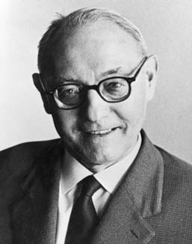
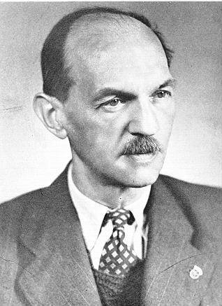
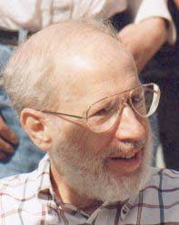
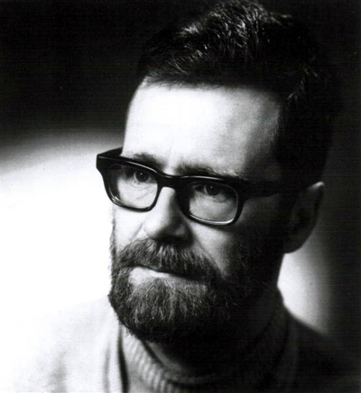
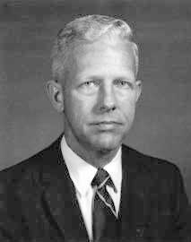
(Old) History of MST algorithms
1920: Otakar Borůvka
1930: Vojtěch Jarník
1956: Kruskal
1957: Prim
1959: Dijkstra

Slide 164
Kruskal’s Algorithm
Input: G=(V,E), c_{e}> 0 for every e in E
T = Ø
Sort edges in increasing order of their cost
Joseph B. Kruskal
Consider edges in sorted order
If an edge can be added to T without adding a cycle then add it to T

Slide 165
Prim’s algorithm
Similar to Dijkstra’s algorithm
2
0.5
1
3
50
51
Robert Prim
2
0.5
Input: G=(V,E), c_{e}> 0 for every e in E
S = {s}, T = Ø
1
50
While S is not the same as V
Among edges e= (u,w) with u in S and w not in S, pick one with minimum cost
Add w to S, e to T

Slide 166
Reverse-Delete Algorithm
2
0.5
1
3
50
51
Input: G=(V,E), c_{e}> 0 for every e in E
2
0.5
T = E
1
3
50
Sort edges in decreasing order of their cost
51
Consider edges in sorted order
If an edge can be removed T without disconnecting T then remove it

Slide 167
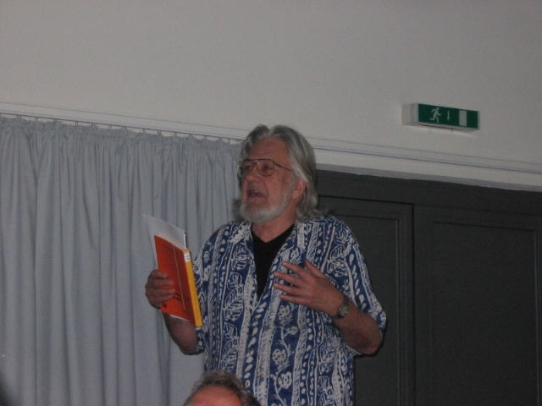
Jack Edmonds

